Slide 1
The Serial-Position Effect Thingy
or The (non)reflexive of serial-position effect
Author/Authors

Slide 2
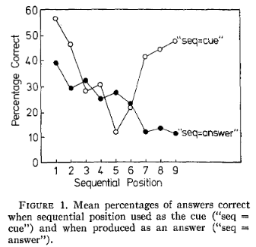
Item-Position Binding
Jones(1976):
Each item has four features: Object, Color, Location, Serial position
Probe one, two, or three features of the item, and participants have to recall the rest.
He found
Little improvement by using two or more cues comparing to single cue condition.
Performance are most reflexive.
Except serial position
The Shadow of previous used context

Slide 3
How we remember the features of the item
MINERVA II (Hintzman, 1984)
The episodic trace consists of the features of the item.
The episodic trace is stored in the memory as a single entity.
GCM (or other multidimensional feature-space model, Nosofsky, Little, Donkin, & Fific, 2011)
An item is a “dot” in the multidimensional feature-space.
The coordinates of the dot represent the value of each features.
SOB (or the models use binding, Oberauer et al., 2012)
Forming the binding between features.
The binding is stored in the memory.
No matter which feature is cued to recall the others, the pattern of the performance is about the same.
Is it so?

Slide 4

Can we simulate this finding?
Simplified SOB model (similar to Start-End model, Henson, 1998)
Neural network model, distributed representation.
Memory is the binding between item and serial position.
The binding is also used for recall.
Parameters
$s_{i}$: the similarity between items.
$s_{pp}$, $s_{pr}$: the similarity between context.

Slide 5
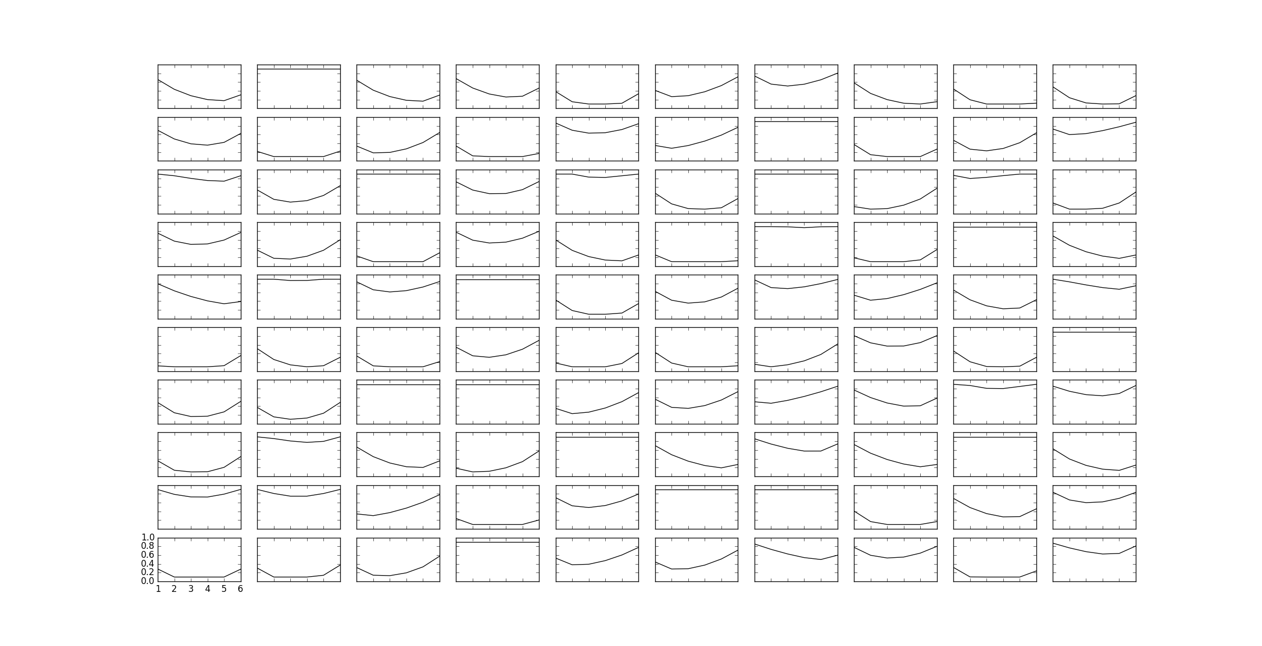

Slide 6
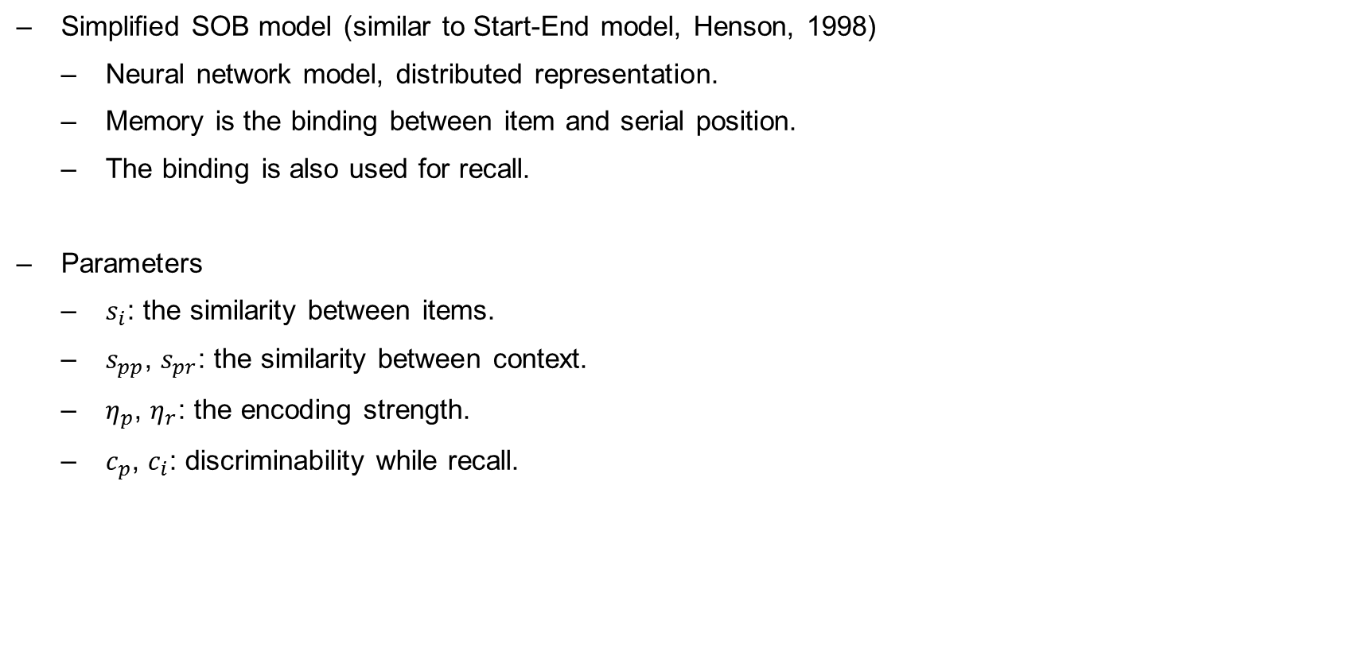
Can we simulate this finding?
Simplified SOB model (similar to Start-End model, Henson, 1998)
Neural network model, distributed representation.
Memory is the binding between item and serial position.
The binding is also used for recall.
Parameters
$s_{i}$: the similarity between items.
$s_{pp}$, $s_{pr}$: the similarity between context.
$η_{p}$, $η_{r}$: the encoding strength.
$c_{p}$, $c_{i}$: discriminability while recall.

Slide 7
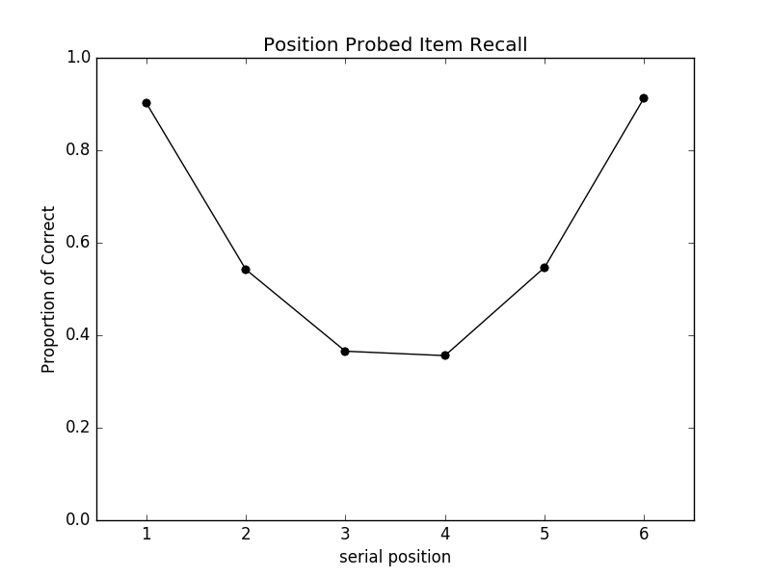
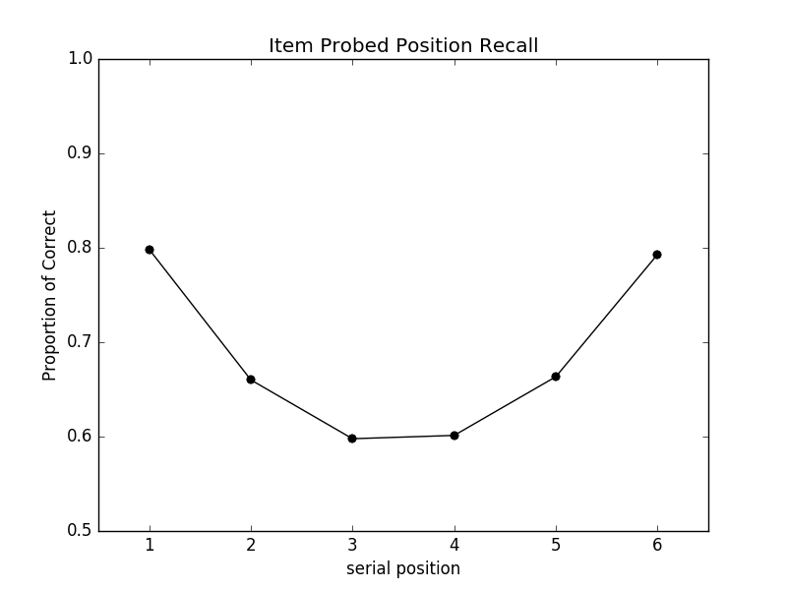
Simulation Nr.1 – Nr.400

Slide 8
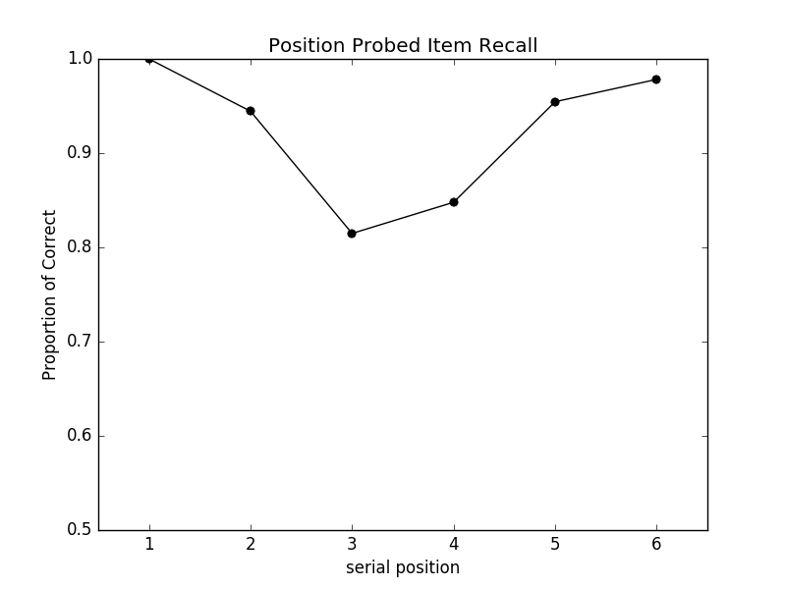
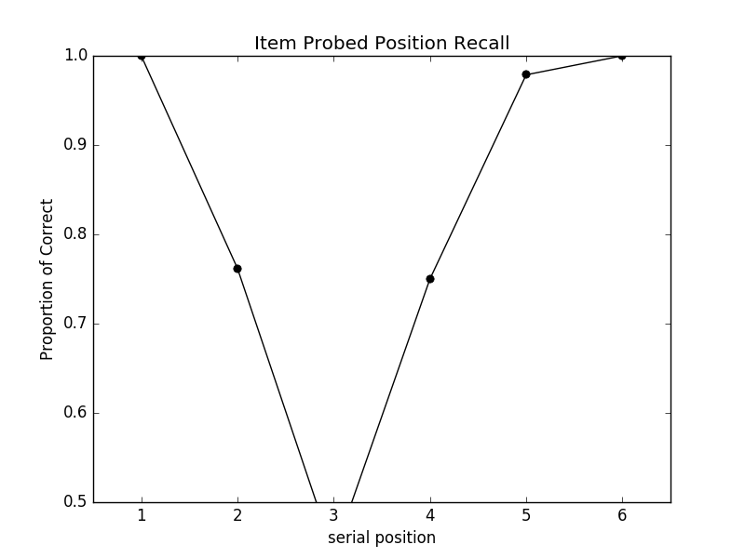

Simulation Nr. 1
Parameters:
$s_{i}$:0.202085301445
$s_{pp}$, $s_{pr}$:0.840514487874, 0.327408601945
$η_{p}$, $η_{r}$:0.434799886474, 0.615076522129
$c_{p}$, $c_{i}$:9.22785235733, 14.3237418447
Primacy/Recency:
ItemRecall(1,2,3)/ItemRecall(4, 5, 6)
PositionRecall(1,2,3)/PositionRecall(4,5,6)
$s_{pp}$/$s_{pr}$
$η_{p}$/$η_{r}$

Slide 9
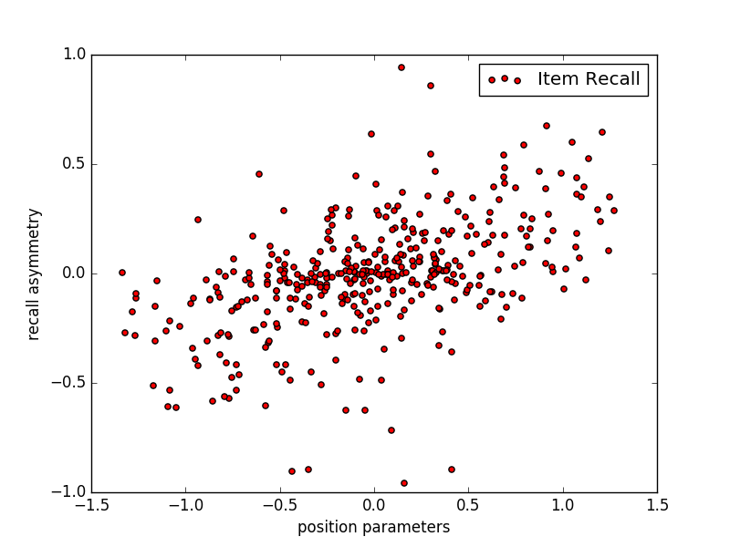
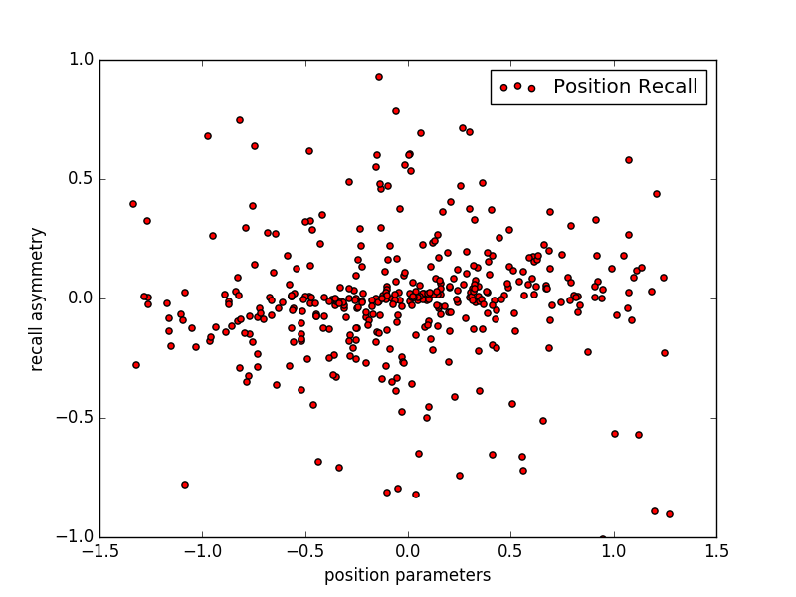
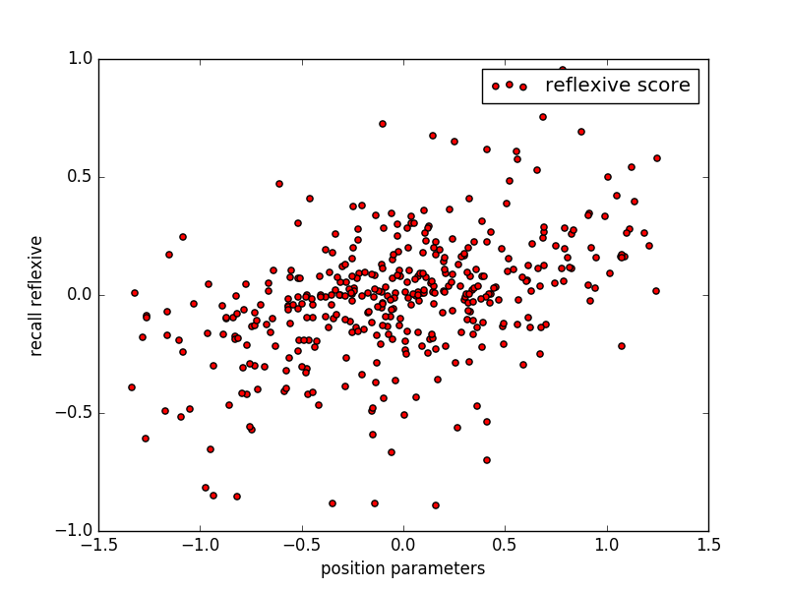
Simulation Nr.1 – Nr.400

Slide 10
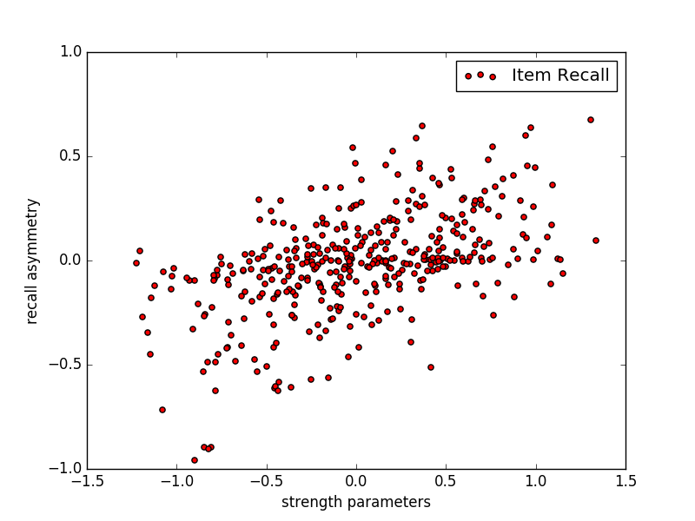
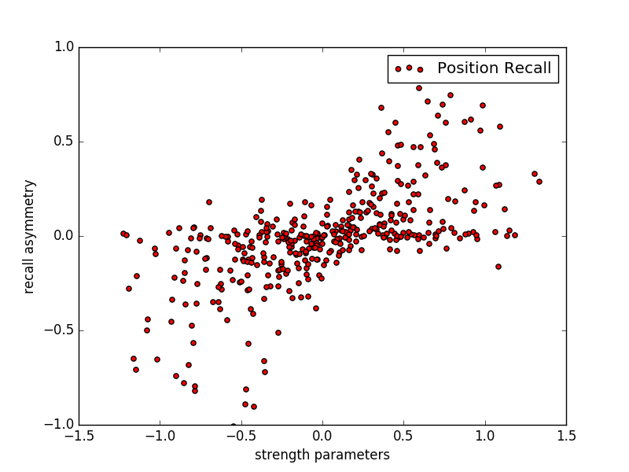
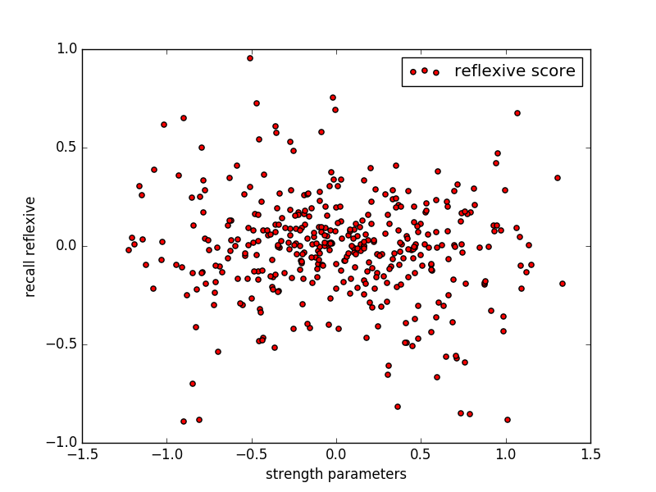
Simulation Nr.1 – Nr.400

Slide 11
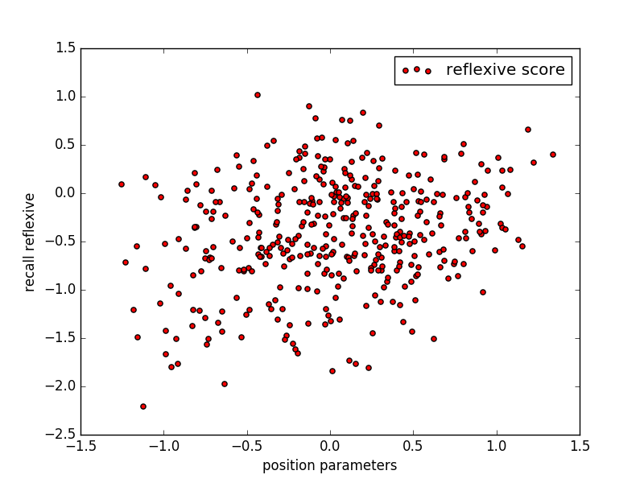
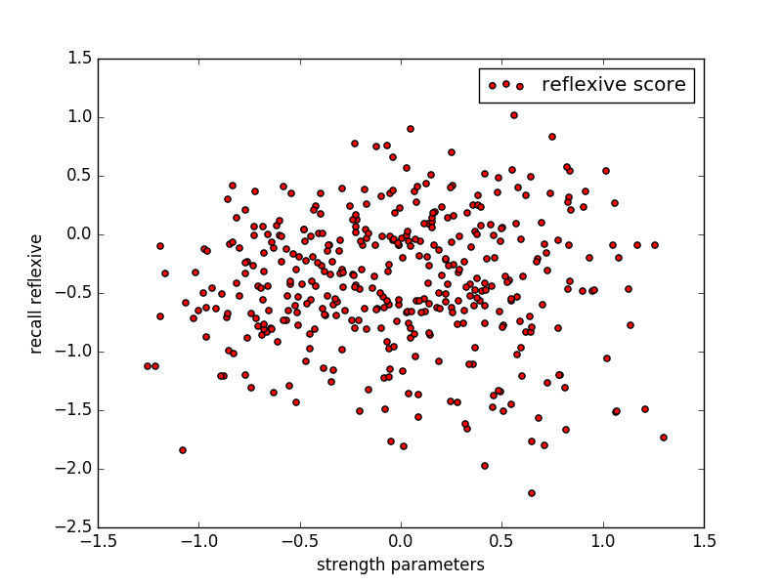
Can we simulate this finding?
Can we?
If the shadow of previous used context affects the encoding process
So no.

Slide 12
Experiment I
Procedure

Slide 13
Geist
Wagen
Berg
Küste
Klima
Klima
2
1
xxx
xxx
xxx
2
xxx
xxx
Wagen
3
xxx
xxx
xxx
4
xxx
xxx
xxx
5
xxx
xxx
xxx

Slide 14
Experiment I
Procedure
Set size: 6
Probe: item, serial position (50%, 50%)
240 trials
17 participants collected, one is excluded because of program crashed.
DV: probability of correct

Slide 15
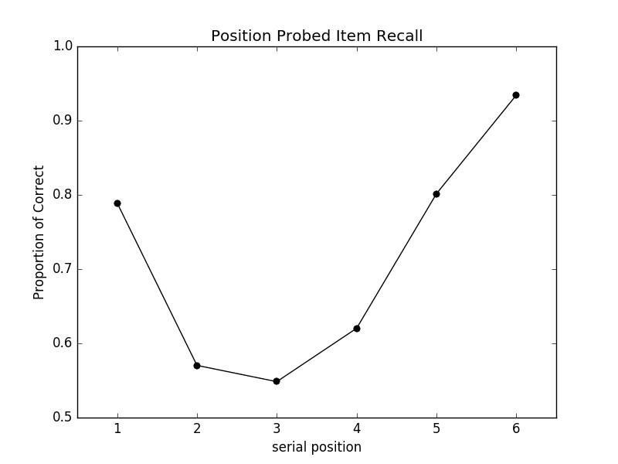
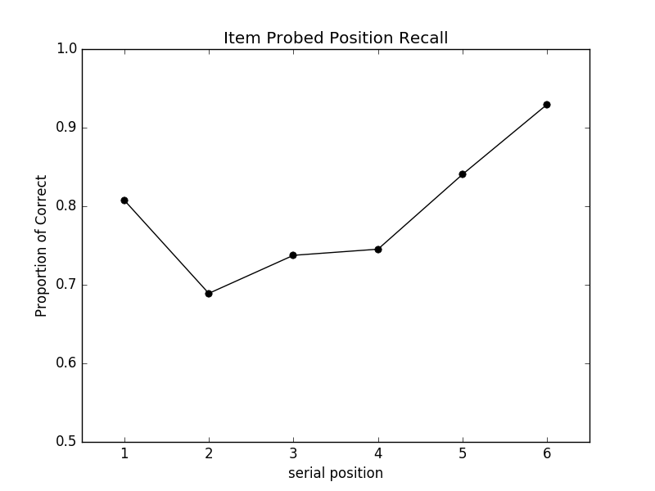
Experiment I – Serial Position Effect

Slide 16
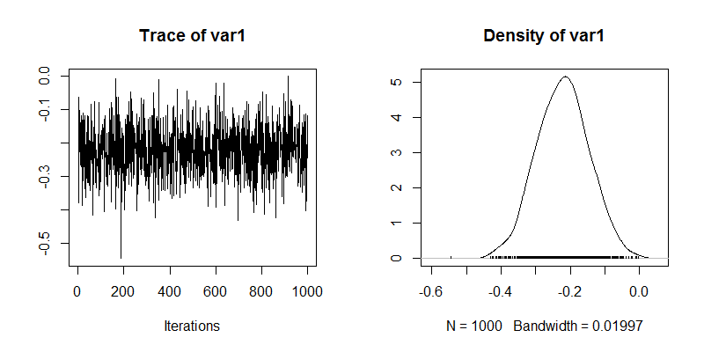
Experiment I – Serial Position Effect
Log(PC(1,2) / PC(5,6)):
Mean: -0.2708
Median: -0.2713
BF: 3.9978

Slide 17
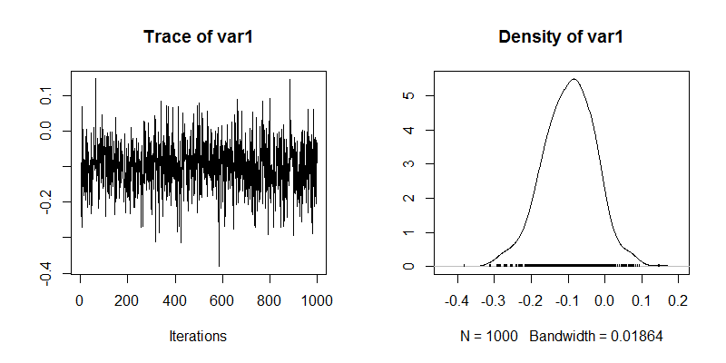
Experiment I – Serial Position Effect
Log(PC(1,2) / PC(5,6)):
Mean: -0.1783
Median: -0.1766
BF: 2.3840

Slide 18
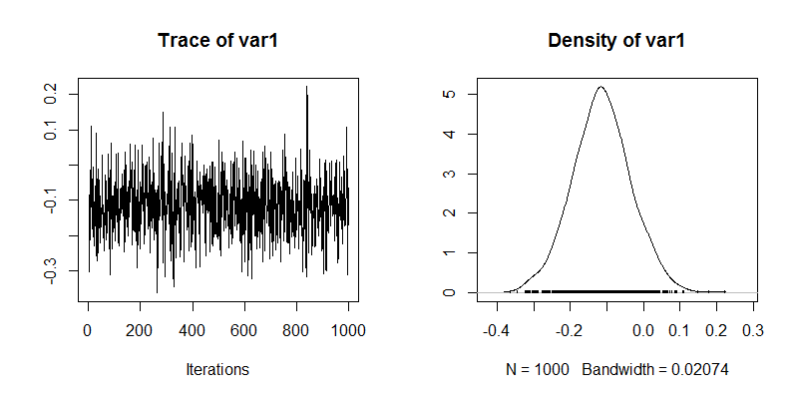
Experiment I – Serial Position Effect
Log(Item Recall / Position Recall):
Mean: -0.0925
Median: -0.1203
BF: 0.4507

Slide 19
Experiment I – Serial Position Effect
Asymmetry for serial-position effect:
Nope
Both trials shown stronger recency gradient over primacy gradient.
What now then? I haven’t done my defense yet.
Transposition gradient

Slide 20
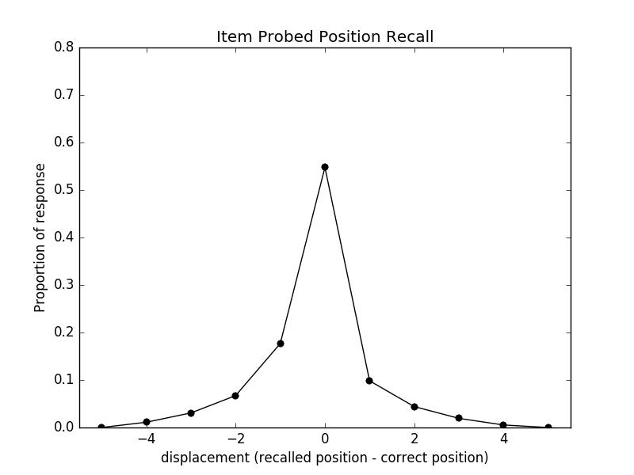
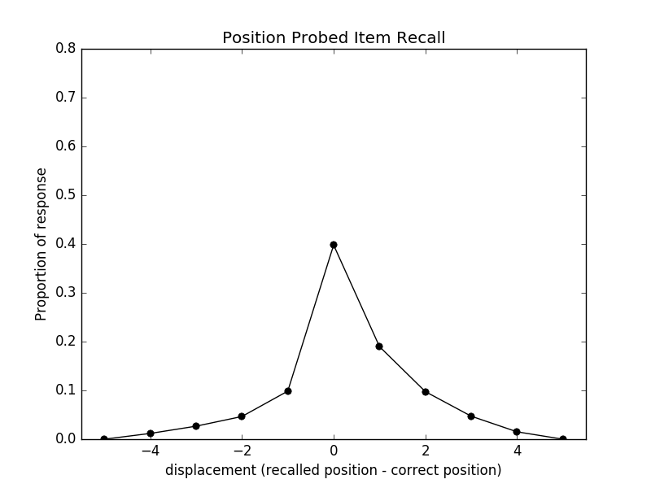
Simulation – Transposition Gradient

Slide 21
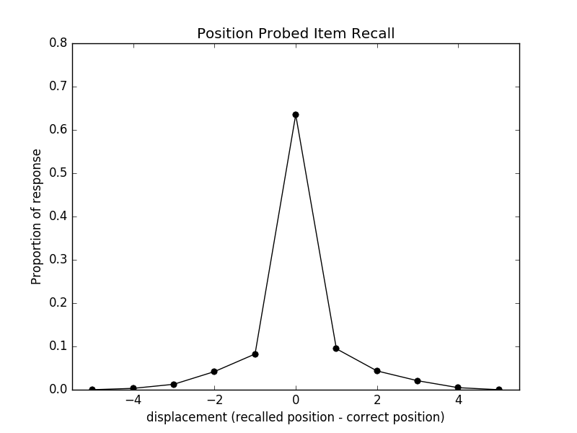
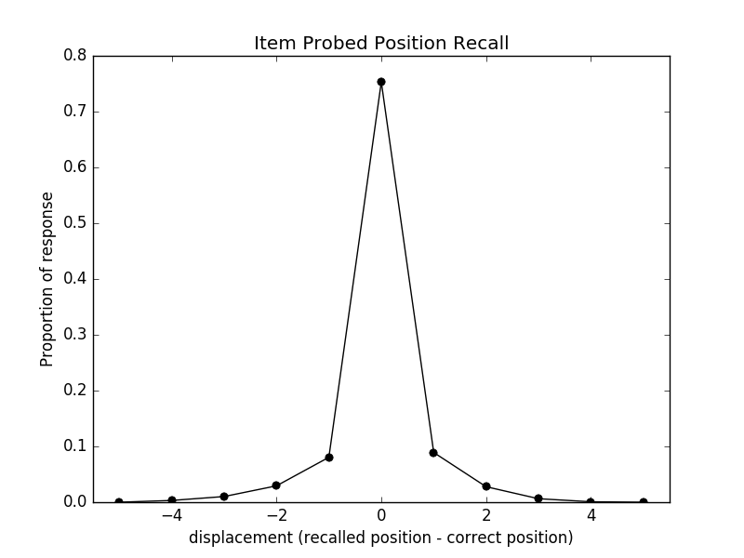
Experiment I – Transposition Gradient

Slide 22
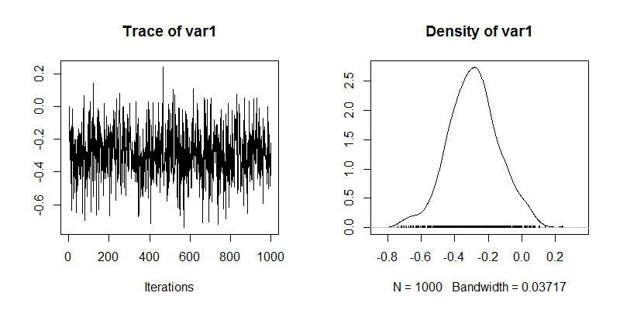
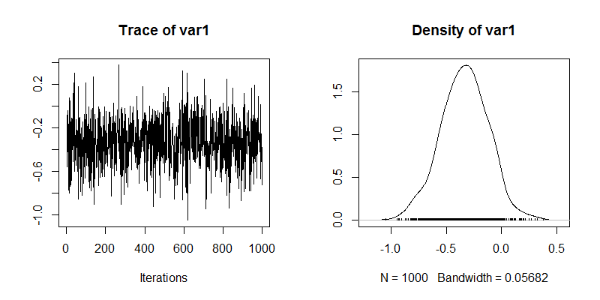
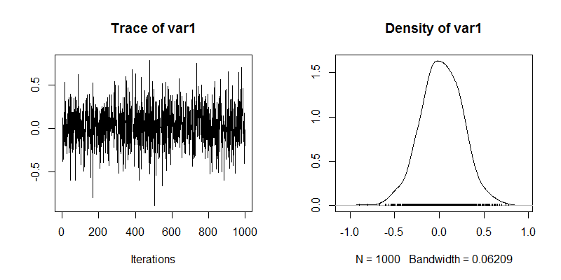
Experiment I – Transposition Gradient
Item Recall:
Mean: -0.3418
Median: -0.2400
BF: 1.7300
Position Recall:
Mean: -0.3846
Median : -0.6405
BF: 0.8436
Item Recall / Position Recall:
Mean: 0.0428
Median : 0.3818
BF: 0.2587

Slide 23
Experiment I – Serial Position Effect
Log(PC(1) / PC(6)):
Mean: -0.1952
Median: -0.1415
BF: 3.1963

Slide 24
Experiment I – Serial Position Effect
Log(PC(1) / PC(4)):
Mean: -0.1755
Median: -0.0882
BF: 1.6670

Slide 25
Experiment I – Serial Position Effect
Log(Item Recall / Position Recall):
Mean: -0.0197
Median: 0.0123
BF: 0.2745

Slide 26
Experiment I – Serial Position Effect
Log(PC(1,2,3) / PC(4,5,6)):
Mean: -0.2477
Median: -0.1163
BF: 10.1421

Slide 27
Experiment I – Serial Position Effect
Log(PC(1,2,3) / PC(4,5,6)):
Mean: -0.1135
Median: -0.1349
BF: 0.6248

Slide 28
Experiment I – Serial Position Effect
Log(Item Recall / Position Recall):
Mean: -0.1342
Median: 0.0555
BF: 0.8428

